Slide 1
Lab. 02
Logic Design Lab.
Spring 2014
Prof. Naehyuck Chang
(naehyuck@snu.ac.kr)
TA. Taeyoung Kim
(tykim@iris.snu.ac.kr)
TA. Duseok Kang
(kangds0829@iris.snu.ac.kr)
RUBIS

Slide 2

Preliminary report
Good example
RUBIS

Slide 3
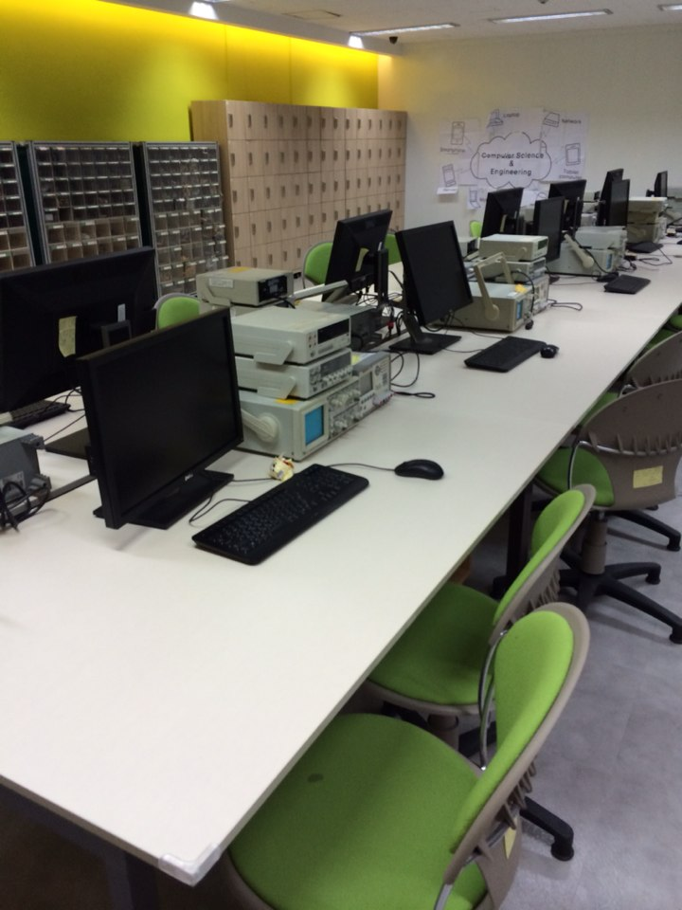
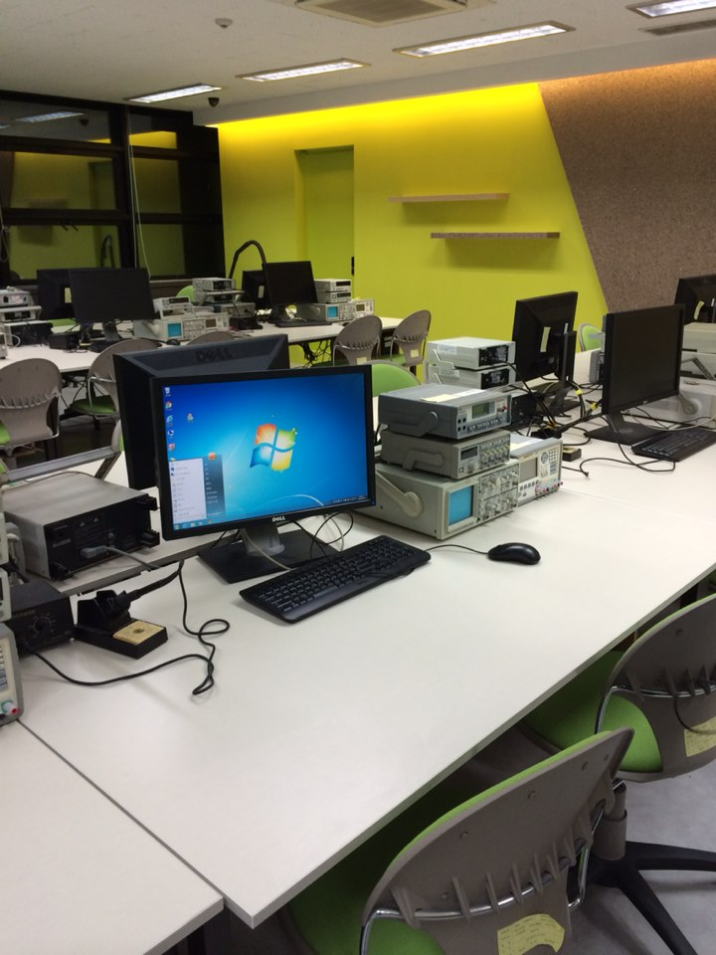
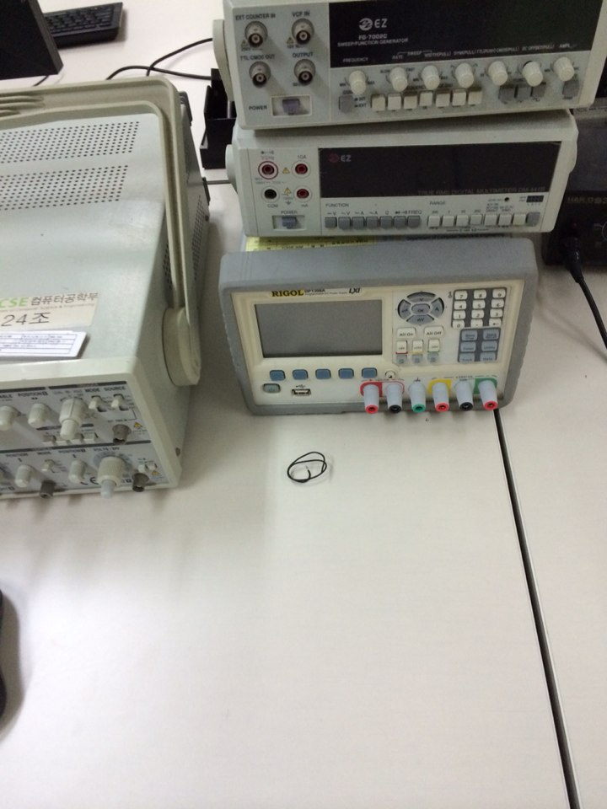
Arrangement
Bad example
RUBIS

Slide 4
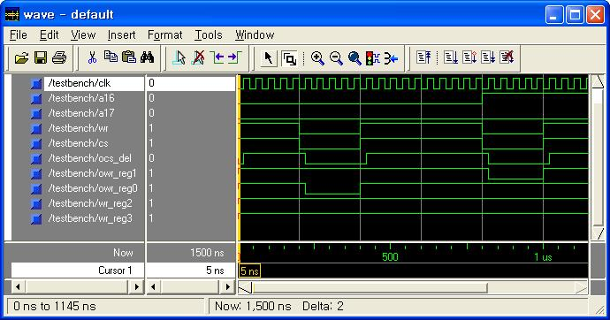
Introduction to Xilinx ISE
Xilinx ISE 14.4
The central electronic design automation (EDA) product family sold by Xilinx.
Includes design entry and synthesis supporting Verilog or VHDL, place-and-route (PAR), completed verification and debug using ChipScope Pro tools, and creation of the bit files that are used to configure the chip.
RUBIS

Slide 5
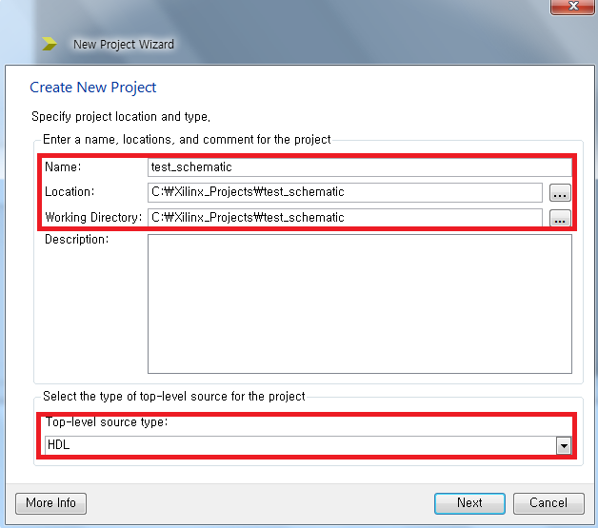
Simulation with ISE
Creating a new project
Select File -> New Project
Specify Name, Location, Working Directory. Select Top-level source type as HDL.
RUBIS

Slide 6
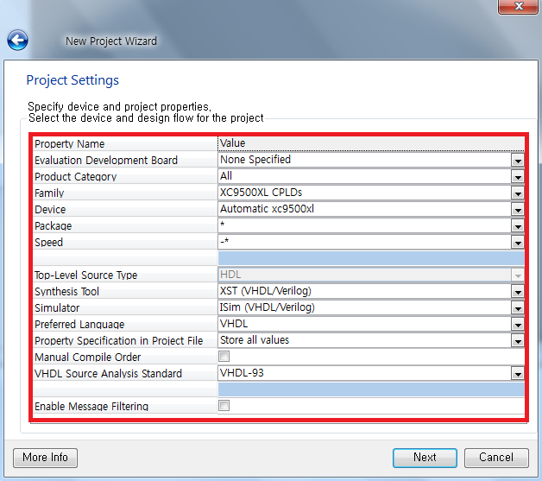
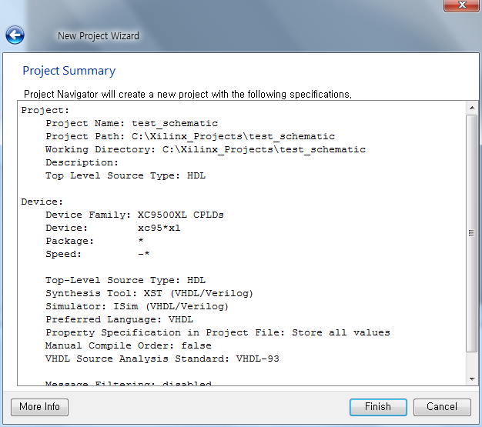
Simulation with ISE
Project Settings
Set Project Settings as above
Click Finish to continue
RUBIS

Slide 7
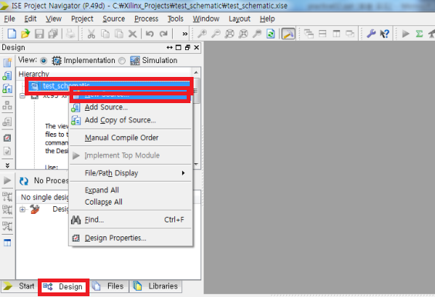
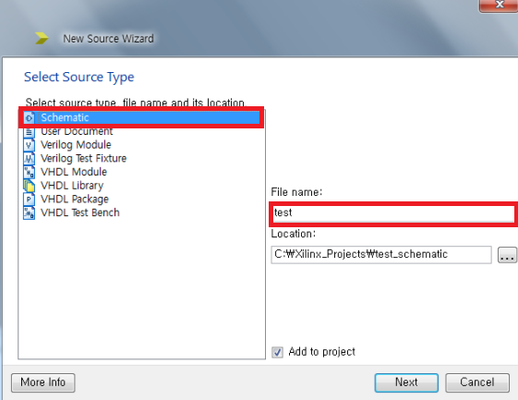
Simulation with ISE
Creating a Schematic
Select Project -> New Source.
A New Source Wizard window appears. In this Select Source Type window, select Schematic and type the File name. Ensure Add to project is checked.
RUBIS

Slide 8
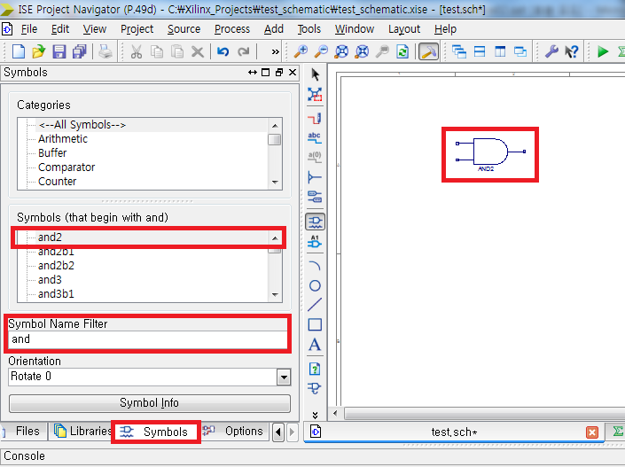
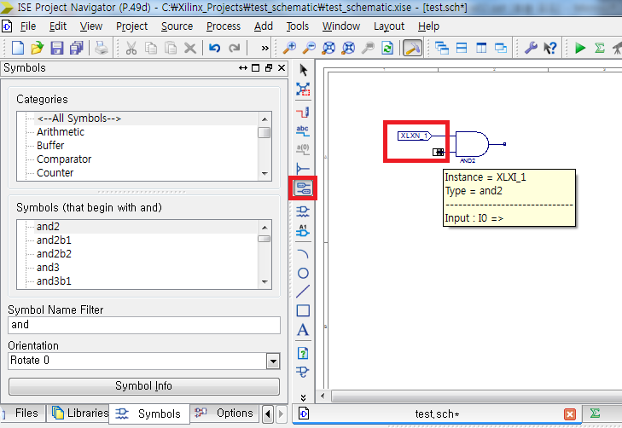
Simulation with ISE
Constructing a 2-input-AND gate circuit (1)
Choose Symbols tab, select and2 and put a 2-input-AND gate on board.
Click I/O Marker button and you can add input/output markers to your circuit.
RUBIS

Slide 9
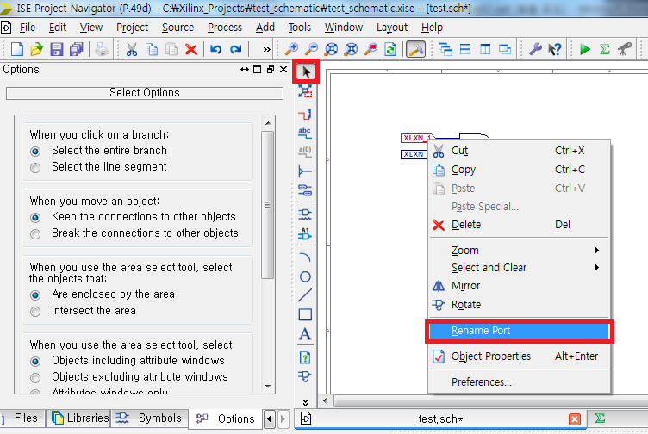
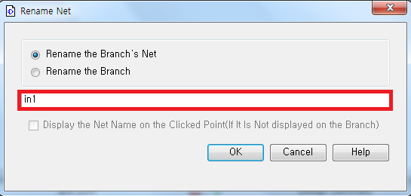
Simulation with ISE
Constructing a 2-input-AND gate circuit (2)
Change the names of input/output symbols.
RUBIS

Slide 10
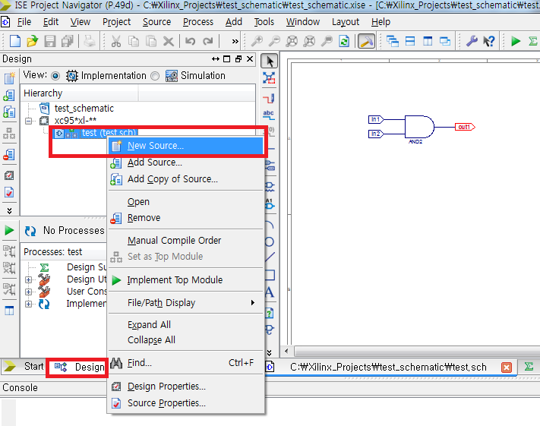
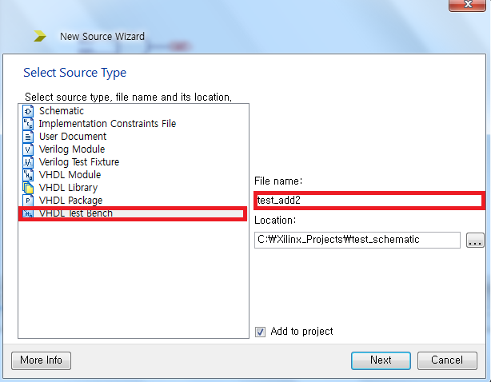
Simulation with ISE
Creating a VHDL Test Bench (1)
Select New Source by right clicking in the Design tab.
Select VHDL Test Bench. Type the file name as above.
RUBIS

Slide 11
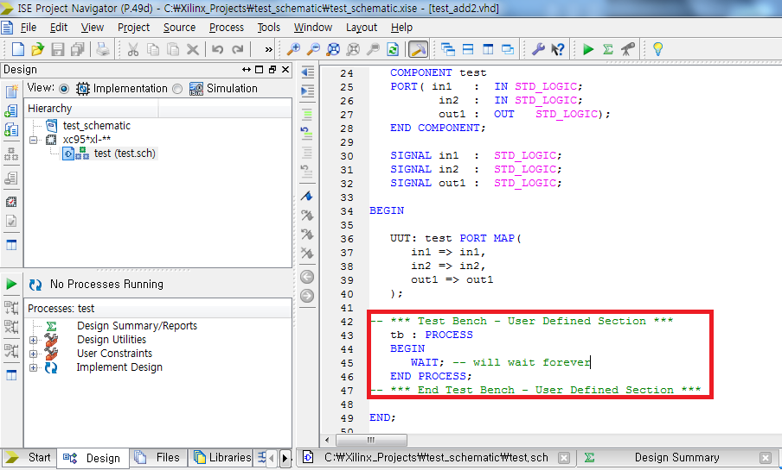
Simulation with ISE
Creating a VHDL Test Bench (2)
RUBIS

Slide 12
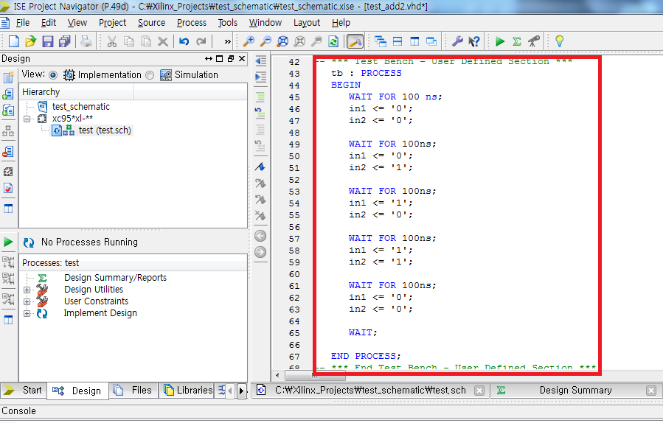
Simulation with ISE
Creating a VHDL Test Bench (3)
Add the VHDL test bench code as shown above.
The process begins with WAIT FOR 100ns, end with a WAIT.
RUBIS

Slide 13
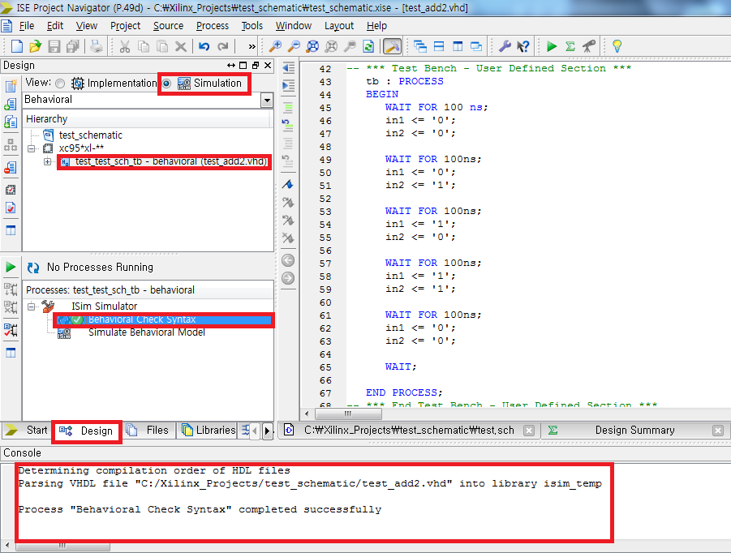
Simulation with ISE
Simulating the Behavioral Model
Save the project by selecting File -> Save.
Double click Behavioral Check Syntax to verify the VHDL code syntax.
Ensure Design tab is selected, View is set to Simulation.
Ensure the Behavioral Check Syntax is correct.
Double click Simulate Behavioral Model.
RUBIS

Slide 14
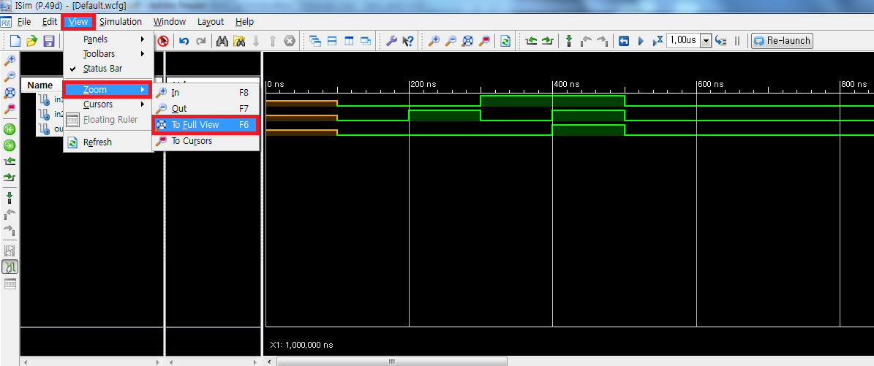
Simulation with ISE
Result
To adjust the view, select View -> Zoom -> To Full View.
RUBIS

Slide 15
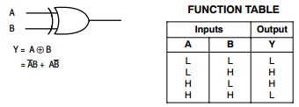
Practice (result report)
Xilinx ISE
Implement 2-input-XOR gate using 2-input-AND, 2-input-OR, Inverter gates.
Confirm your implementation using Xilinx ISE.
Capture the simulation result and make out the report including those pictures. ( due : 17, March )
RUBIS

Slide 16
Preliminary report
You can write this report by Korean or English as you want
There is no format
You don’t have to make the cover page
You should write equal or less than 3 pages
You should include below things in your report
  Prototyping & Soldering ( due : 12, March )
    Tools
      solder(연납), soldering iron(인두), desolder,
      nipper, long-nose plier, bead nipper
    Basic soldering procedure
RUBIS

